Slide 1
Resource Allocation for ISAC Networks with Application to Target Tracking
AUTHORS
Lu Wang | Luis F. Abanto-Leon
PUBLISHER / VENUE
2024 IEEE Globecom Workshops (GC Wkshps)
Conference date: 08-12 December 2024
Added to IEEE Xplore: 12 August 2025

Slide 2
Table of Contents
Table of contents:
01
Paper overview
Slides 3-5 | Motivation, research gap, proposed resource framework
04
Optimization problem
Slides 28-32 | Joint variables, QoS constraints, power/RB limits
02
ISAC system and sensing model
Slides 6-16 | Protocol, resources, echo model, target measurements
05
PCRB objective reformulation
Slides 33-45 | Resource-dependent FIM, scalarization, SCA relaxation
03
Tracking and communication models
Slides 17-27 | Posterior CRB, EKF update, UE channel and throughput
06
BCD solution flow
Slides 46-54 | Penalty method, beam search, sensing power update

Slide 3
Abstract
Motivation and Research Gap
  Dynamic ISAC Resource for 6G
    6G ISAC integrates sensing and communication in one system
    Limited resources may increase traffic congestion
    Existing methods are insufficient for :
      Frequent target tracking in every frame
      Simultaneous communication with users
      Target movement and time-varying channels

Slide 4
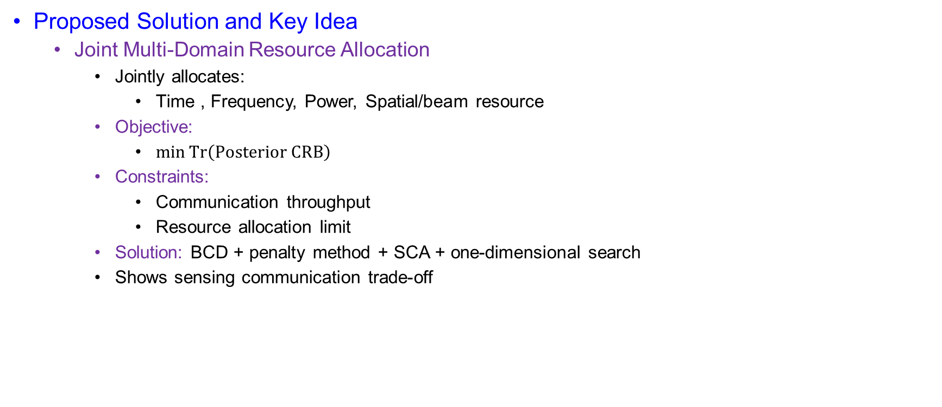
Abstract
Proposed Solution and Key Idea
  Joint Multi-Domain Resource Allocation
    Jointly allocates:
      Time , Frequency, Power, Spatial/beam resource
    Objective:
      $\min{Tr\left(Posterior CRB\right)}$
    Constraints:
      Communication throughput
      Resource allocation limit
    Solution: BCD + penalty method + SCA + one-dimensional search
    Shows sensing communication trade-off

Slide 5
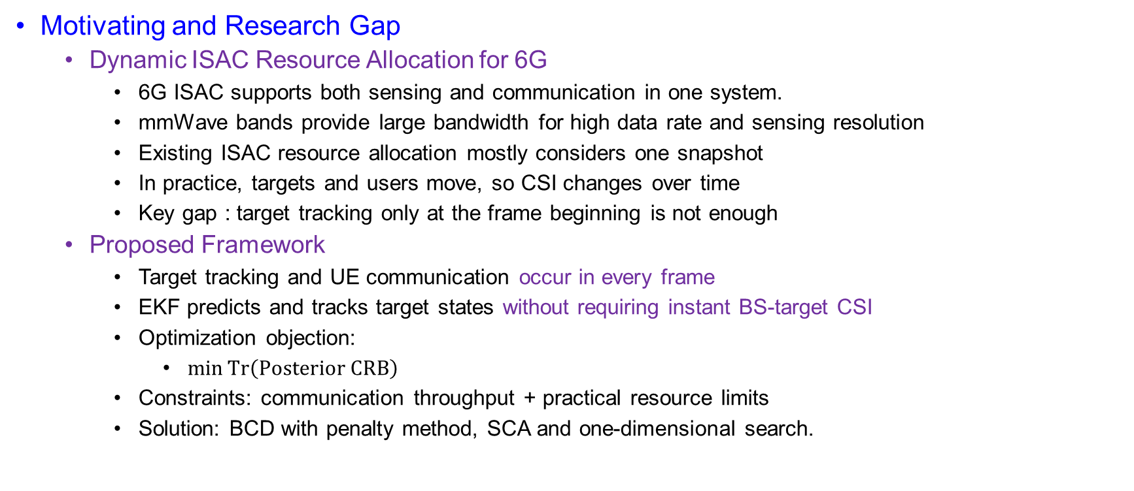
Introduction
Motivating and Research Gap
  Dynamic ISAC Resource Allocation for 6G
    6G ISAC supports both sensing and communication in one system.
    mmWave bands provide large bandwidth for high data rate and sensing resolution
    Existing ISAC resource allocation mostly considers one snapshot
    In practice, targets and users move, so CSI changes over time
    Key gap : target tracking only at the frame beginning is not enough
  Proposed Framework
    Target tracking and UE communication occur in every frame
    EKF predicts and tracks target states without requiring instant BS-target CSI
    Optimization objection:
      $\min{Tr\left(Posterior CRB\right)}$
    Constraints: communication throughput + practical resource limits
    Solution: BCD with penalty method, SCA and one-dimensional search.

Slide 6
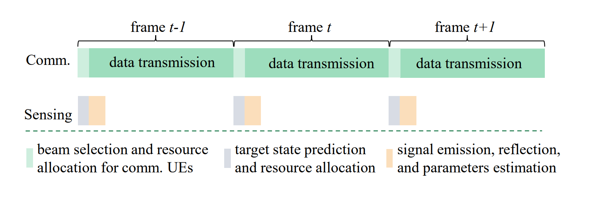
System Model
Fig.1. Transmission protocol of ISAC system

Slide 7

System Model
mmWave ISAC Network
  BS with ULA:
    $N_{t}$ transmit antennas
    $N_{r}$ receive antennas
  Serves:
    $M$ moving targets
    $K$ single-antenna Ues.
  Performs joint:
    Communication
    Location tracking
  At the beginning of each frame:
    Resources are allocated
    Target states are predicted

Slide 8

System Model
Resource Allocation Model
  Four-Dimensional Resource Allocation
    Frequency: resource blocks RBS
    Time: mini-slots
    Power: transmit power
    Spatial: beams
  Each resource constraint:
    $RU=1 RB+1 mini−slot$
  Total resource constraint:
    $\sum_{m=1}^{M}{n_{m}^{u}+ \sum_{k=1}^{K}{\sum_{i=1}^{I}{o_{k,1}^{u}≤I×N_{RB}}}}$
  Allocated bandwidth:
    $n_{m}^{u}B_{0}$ for target $m$
    $o_{k,1}^{u}B_{0}$ for UE $k$

Slide 9
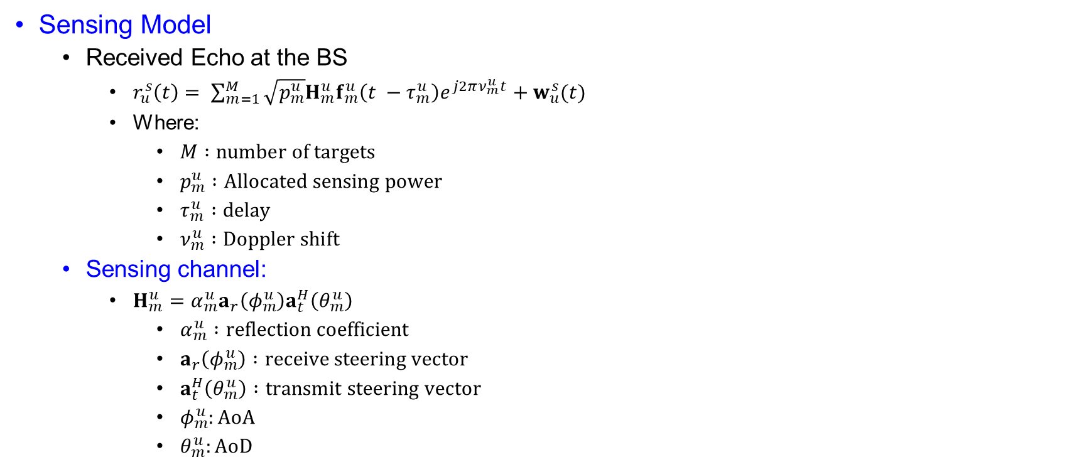
System Model
Sensing Model
  Received Echo at the BS
    $r_{u}^{s}\left(t\right)= \sum_{m=1}^{M}{\sqrt{p_{m}^{u}}H_{m}^{u}f_{m}^{u}\left(t −τ_{m}^{u}\right)e^{j2πν_{m}^{u}t}+w_{u}^{s}(t)}$
    Where:
      $M :number of targets$
      $p_{m}^{u} :Allocated sensing power$
      $τ_{m}^{u} :delay$
      $ν_{m}^{u} :Doppler shift$
  Sensing channel:
    $H_{m}^{u}=α_{m}^{u}a_{r}\left(φ_{m}^{u}\right)a_{t}^{H}\left(θ_{m}^{u}\right)$
      $α_{m}^{u} :reflection coefficient$
      $a_{r}\left(φ_{m}^{u}\right) :receive steering vector$
      $a_{t}^{H}\left(θ_{m}^{u}\right) :transmit steering vector$
      $φ_{m}^{u}:AoA$
      $θ_{m}^{u}:AoD$

Slide 10
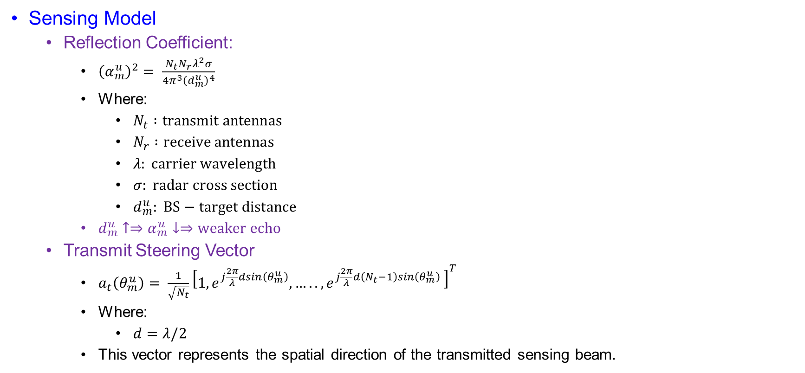
System Model
Sensing Model
  Reflection Coefficient:
    ${\left(α_{m}^{u}\right)}^{2}= \frac{N_{t}N_{r}λ^{2}σ}{4π^{3}{\left(d_{m}^{u}\right)}^{4}}$
    Where:
      $N_{t} :transmit antennas$
      $N_{r} :receive antennas$
      $λ: carrier wavelength$
      $σ: radar cross section$
      $d_{m}^{u}: BS−target distance$
    $d_{m}^{u}↑⇒α_{m}^{u}↓⇒weaker echo$
  Transmit Steering Vector
    $a_{t}\left(θ_{m}^{u}\right)= \frac{1}{\sqrt{N_{t}}}{\left[1,e^{j\frac{2π}{λ}dsin\left(θ_{m}^{u}\right)},…..,e^{j\frac{2π}{λ}d\left(N_{t}−1\right)sin\left(θ_{m}^{u}\right) }\right]}^{T}$
    Where:
      $d=λ/2$
    This vector represents the spatial direction of the transmitted sensing beam.

Slide 11
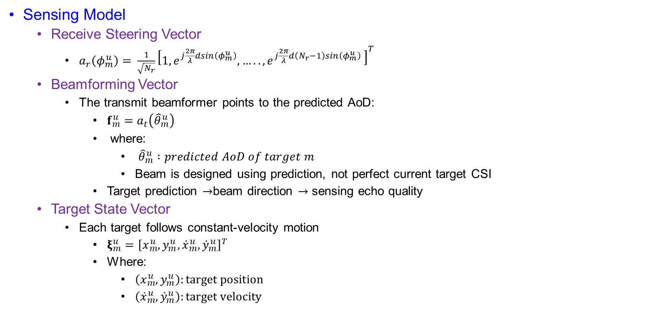
System Model
Sensing Model
  Receive Steering Vector
    $a_{r}\left(φ_{m}^{u}\right)= \frac{1}{\sqrt{N_{r}}}{\left[1,e^{j\frac{2π}{λ}dsin\left(φ_{m}^{u}\right)},…..,e^{j\frac{2π}{λ}d\left(N_{r}−1\right)sin\left(φ_{m}^{u}\right) }\right]}^{T}$
  Beamforming Vector
    The transmit beamformer points to the predicted AoD:
      $f_{m}^{u}=a_{t}\left({\hat{θ}}_{m}^{u}\right)$
      where:
        ${\hat{θ}}_{m}^{u} :predicted AoD of target m$
        Beam is designed using prediction, not perfect current target CSI
      Target prediction $→$beam direction $→$ sensing echo quality
  Target State Vector
    Each target follows constant-velocity motion
      $ξ_{m}^{u}={\left[x_{m}^{u},y_{m}^{u},{\dot{x}}_{m}^{u},{\dot{y}}_{m}^{u}\right]}^{T}$
      Where:
        $\left(x_{m}^{u},y_{m}^{u}\right):target position$
        $\left({\dot{x}}_{m}^{u},{\dot{y}}_{m}^{u}\right):target velocity$

Slide 12
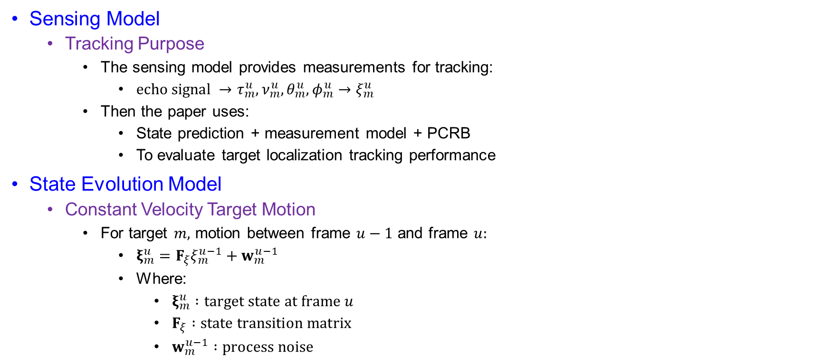
System Model
Sensing Model
  Tracking Purpose
    The sensing model provides measurements for tracking:
      $echo signal →τ_{m}^{u},ν_{m}^{u},θ_{m}^{u},φ_{m}^{u}→ξ_{m}^{u}$
    Then the paper uses:
      State prediction + measurement model + PCRB
      To evaluate target localization tracking performance
State Evolution Model
  Constant Velocity Target Motion
    For target $m,$ motion between frame $u−1$ and frame $u:$
      $ξ_{m}^{u}=F_{ξ}ξ_{m}^{u−1}+w_{m}^{u−1}$
      Where:
        $ξ_{m}^{u} :target state at frame u$
        $F_{ξ} :state transition matrix$
        $w_{m}^{u−1} :process noise$

Slide 13
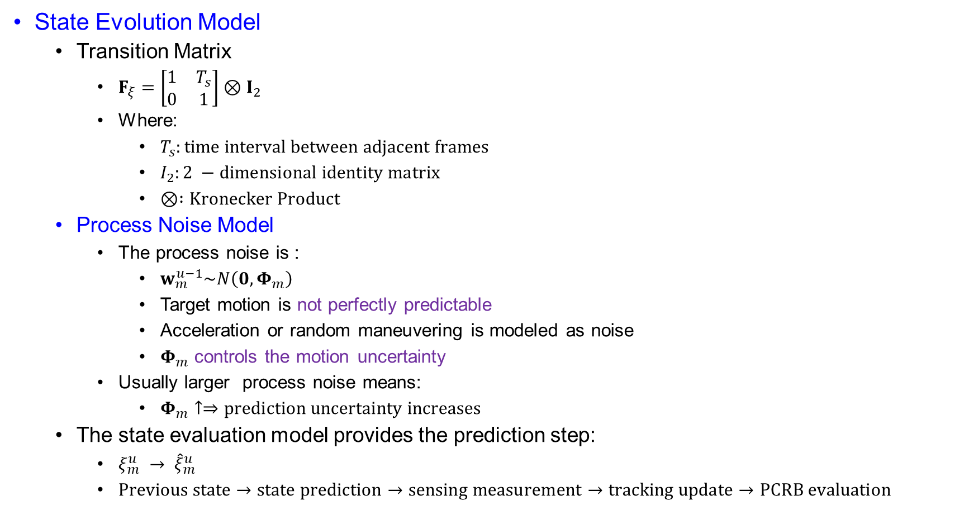
System Model
State Evolution Model
  Transition Matrix
    $F_{ξ}=\left[\begin{matrix}1 & T_{s} \\ 0 & 1\end{matrix}\right]⊗I_{2}$
    Where:
      $T_{s}:time interval between adjacent frames$
      $I_{2}:2 −dimensional identity matrix$
      $⊗ :Kronecker Product$
  Process Noise Model
    The process noise is :
      $w_{m}^{u−1}\sim N\left(0,Φ_{m}\right)$
      Target motion is not perfectly predictable
      Acceleration or random maneuvering is modeled as noise
      $Φ_{m}$ controls the motion uncertainty
    Usually larger process noise means:
      $Φ_{m}↑⇒prediction uncertainty increases$
  The state evaluation model provides the prediction step:
    $ξ_{m}^{u} → {\hat{ξ}}_{m}^{u}$
    $Previous state→state prediction→sensing measurement→tracking update→PCRB evaluation$

Slide 14
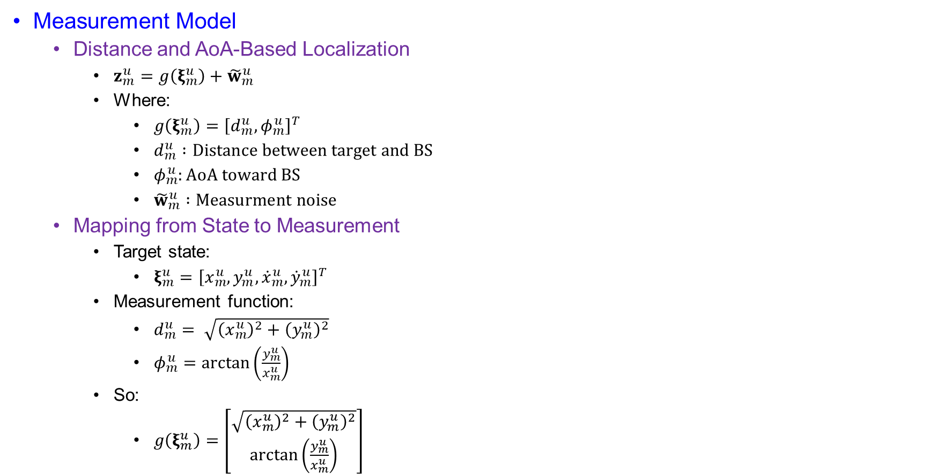
System Model
Measurement Model
  Distance and AoA-Based Localization
    $z_{m}^{u}=g\left(ξ_{m}^{u}\right)+{\tilde{w}}_{m}^{u}$
    Where:
      $g\left(ξ_{m}^{u}\right)={\left[d_{m}^{u},φ_{m}^{u}\right]}^{T}$
      $d_{m}^{u} :Distance between target and BS$
      $φ_{m}^{u}:AoA toward BS$
      ${\tilde{w}}_{m}^{u} :Measurment noise$
  Mapping from State to Measurement
    Target state:
      $ξ_{m}^{u}={\left[x_{m}^{u},y_{m}^{u},{\dot{x}}_{m}^{u},{\dot{y}}_{m}^{u}\right]}^{T}$
    Measurement function:
      $d_{m}^{u}= \sqrt{{\left(x_{m}^{u}\right)}^{2}+{\left(y_{m}^{u}\right)}^{2}}$
      $φ_{m}^{u}=\arctan\left(\frac{y_{m}^{u}}{x_{m}^{u}}\right)$
    So:
      $g\left(ξ_{m}^{u}\right)=\left[\begin{matrix}\sqrt{{\left(x_{m}^{u}\right)}^{2}+{\left(y_{m}^{u}\right)}^{2}} \\ \arctan\left(\frac{y_{m}^{u}}{x_{m}^{u}}\right)\end{matrix}\right]$

Slide 15

System Model
Measurement Model
  Measurement Noise Covariance
    ${\tilde{w}}_{m}^{u}\sim N(0,Σ_{m}^{u})$
    $Σ_{m}^{u}=diag \left(σ_{d_{m}^{u}}^{2}, σ_{φ_{m}^{u}}^{2}\right)$
    $σ_{d_{m}^{u}}^{2}: distance estimation error variance$
    $σ_{φ_{m}^{u}}^{2} :AoA estimatin error variance$
  Distance Estimatin CRB
    $σ_{d_{m}^{u}}^{2}∝{\left(p_{m}^{u}{\left\|H_{m}^{u}f_{m}^{u}\right\|}_{2}^{2}{\left(n_{m}^{u}B_{0}\right)}^{2}\right)}^{−1}$
    $p_{m}^{u}↑⇒σ_{d_{m}^{u}}^{2}↓$
    $n_{m}^{u}B_{0}↑⇒ σ_{d_{m}^{u}}^{2}↓$
    So distance accuracy improves with:
      Higher sensing power
      Stronger sensing power
      Larger allocated bandwidth

Slide 16
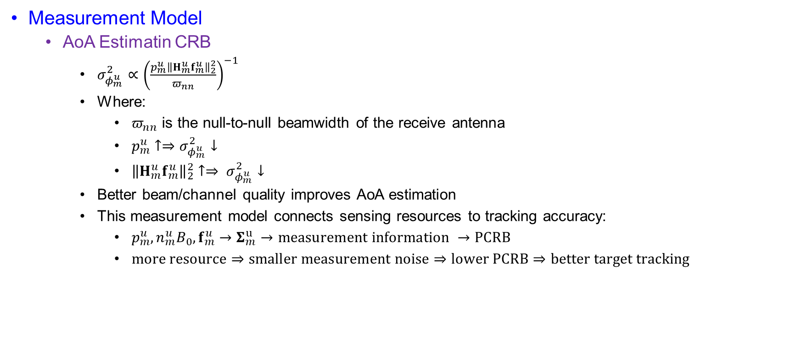
System Model
Measurement Model
  AoA Estimatin CRB
    $σ_{φ_{m}^{u}}^{2}∝{\left(\frac{p_{m}^{u}{\left\|H_{m}^{u}f_{m}^{u}\right\|}_{2}^{2}}{π_{nn}}\right)}^{−1}$
    Where:
      $π_{nn}$ is the null-to-null beamwidth of the receive antenna
      $p_{m}^{u}↑⇒σ_{φ_{m}^{u}}^{2}↓$
      ${\left\|H_{m}^{u}f_{m}^{u}\right\|}_{2}^{2}↑⇒ σ_{φ_{m}^{u}}^{2}↓$
    Better beam/channel quality improves AoA estimation
    This measurement model connects sensing resources to tracking accuracy:
      $p_{m}^{u},n_{m}^{u}B_{0}, f_{m}^{u}→Σ_{m}^{u}→measurement information →PCRB$
      $more resource⇒smaller measurement noise⇒lower PCRB⇒better target tracking$

Slide 17
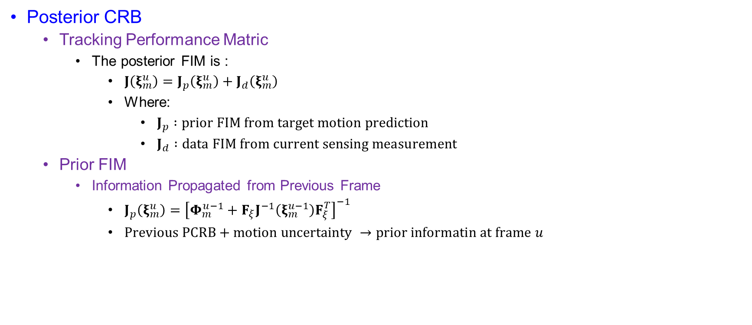
System Model
Posterior CRB
  Tracking Performance Matric
    The posterior FIM is :
      $J\left(ξ_{m}^{u}\right)=J_{p}\left(ξ_{m}^{u}\right)+J_{d}\left(ξ_{m}^{u}\right)$
      Where:
        $J_{p} :prior FIM from target motion prediction$
        $J_{d} :data FIM from current sensing measurement$
  Prior FIM
    Information Propagated from Previous Frame
      $J_{p}\left(ξ_{m}^{u}\right)={\left[Φ_{m}^{u−1}+F_{ξ}J^{−1}\left(ξ_{m}^{u−1}\right)F_{ξ}^{T}\right]}^{−1}$
      $Previous PCRB+motion uncertainty →prior informatin at frame u$

Slide 18
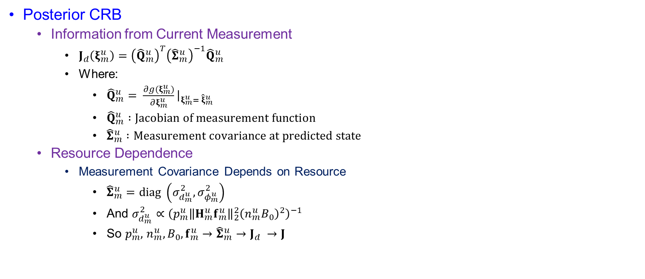
System Model
Posterior CRB
  Information from Current Measurement
    $J_{d}\left(ξ_{m}^{u}\right)={\left({\hat{Q}}_{m}^{u}\right)}^{T}{\left({\hat{Σ}}_{m}^{u}\right)}^{−1}{\hat{Q}}_{m}^{u}$
    Where:
      ${\hat{Q}}_{m}^{u}= \frac{∂g(ξ_{m}^{u})}{∂ξ_{m}^{u}}{\left.​\right|}_{ξ_{m}^{u}= {\hat{ξ}}_{m}^{u}}$
      ${\hat{Q}}_{m}^{u} :Jacobian of measurement function$
      ${\hat{Σ}}_{m}^{u} :Measurement covariance at predicted state$
  Resource Dependence
    Measurement Covariance Depends on Resource
      ${\hat{Σ}}_{m}^{u}=diag \left(σ_{d_{m}^{u}}^{2}, σ_{φ_{m}^{u}}^{2}\right)$
      And $σ_{d_{m}^{u}}^{2}∝{\left(p_{m}^{u}{\left\|H_{m}^{u}f_{m}^{u}\right\|}_{2}^{2}{\left(n_{m}^{u}B_{0}\right)}^{2}\right)}^{−1}$
      So $p_{m}^{u},$ $n_{m}^{u},B_{0},f_{m}^{u}→{\hat{Σ}}_{m}^{u}→J_{d} →J$

Slide 19

System Model
Posterior CRB
  Predictive PCRB
    Inverse of Posterior FIM
      The predictive PCRB is
        $PCRB=J^{−1}\left(ξ_{m}^{u}\right)$
      Tracking performance is evaluated by:
        $tr(J^{−1}\left(ξ_{m}^{u}\right))$
      Smaller trace:
        Lower tracking uncertainty $⇒$better localization tracking

Slide 20
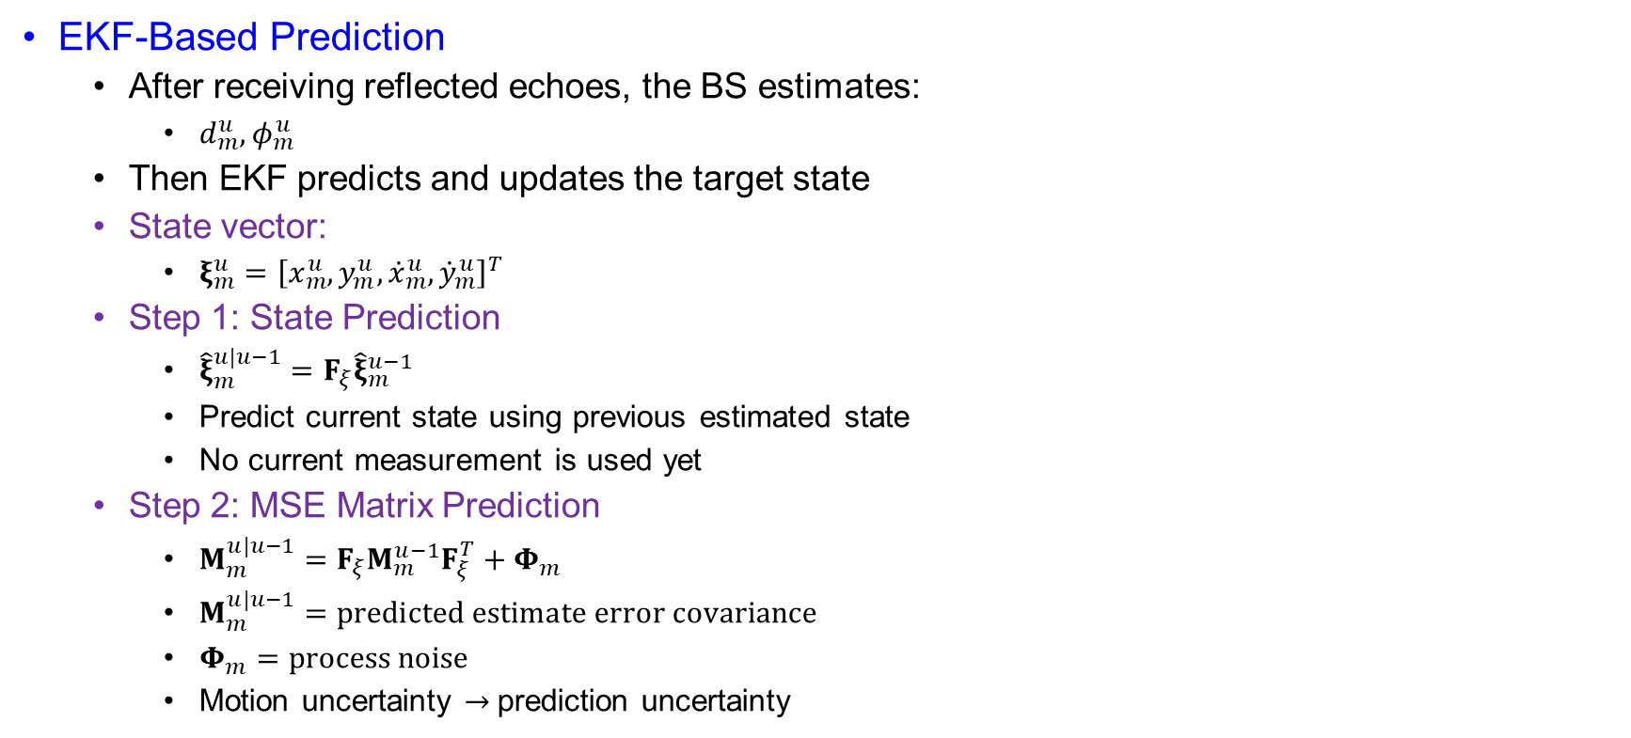
System Model
EKF-Based Prediction
  After receiving reflected echoes, the BS estimates:
    $d_{m}^{u},φ_{m}^{u}$
  Then EKF predicts and updates the target state
  State vector:
    $ξ_{m}^{u}={\left[x_{m}^{u},y_{m}^{u},{\dot{x}}_{m}^{u},{\dot{y}}_{m}^{u}\right]}^{T}$
  Step 1: State Prediction
    ${\hat{ξ}}_{m}^{u|u−1}=F_{ξ}{\hat{ξ}}_{m}^{u−1 }$
    Predict current state using previous estimated state
    No current measurement is used yet
  Step 2: MSE Matrix Prediction
    $M_{m}^{u|u−1}=F_{ξ}M_{m}^{u−1}F_{ξ}^{T}+Φ_{m}$
    $M_{m}^{u|u−1}=predicted estimate error covariance$
    $Φ_{m}=process noise$
    Motion uncertainty $→$prediction uncertainty

Slide 21
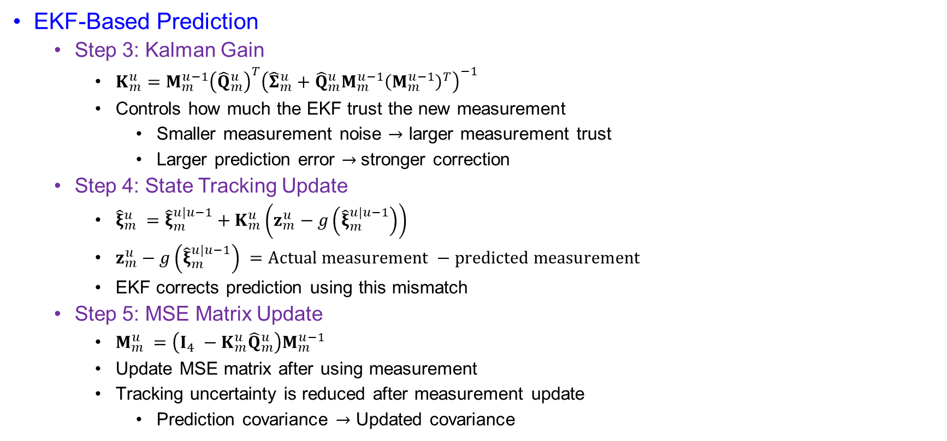
System Model
EKF-Based Prediction
  Step 3: Kalman Gain
    $K_{m}^{u}=M_{m}^{u−1}{\left({\hat{Q}}_{m}^{u}\right)}^{T}{\left({\hat{Σ}}_{m}^{u}+{\hat{Q}}_{m}^{u}M_{m}^{u−1}{\left(M_{m}^{u−1}\right)}^{T}\right)}^{−1}$
    Controls how much the EKF trust the new measurement
      Smaller measurement noise $→$ larger measurement trust
      Larger prediction error $→$stronger correction
  Step 4: State Tracking Update
    ${\hat{ξ}}_{m}^{u} ={\hat{ξ}}_{m}^{u|u−1}+K_{m}^{u}\left(z_{m}^{u}−g\left({\hat{ξ}}_{m}^{u|u−1}\right)\right)$
    $z_{m}^{u}−g\left({\hat{ξ}}_{m}^{u|u−1}\right) =Actual measurement −predicted measurement$
    EKF corrects prediction using this mismatch
  Step 5: MSE Matrix Update
    $M_{m}^{u} =\left(I_{4} −K_{m}^{u}{\hat{Q}}_{m}^{u}\right)M_{m}^{u−1}$
    Update MSE matrix after using measurement
    Tracking uncertainty is reduced after measurement update
      Prediction covariance $→$ Updated covariance

Slide 22
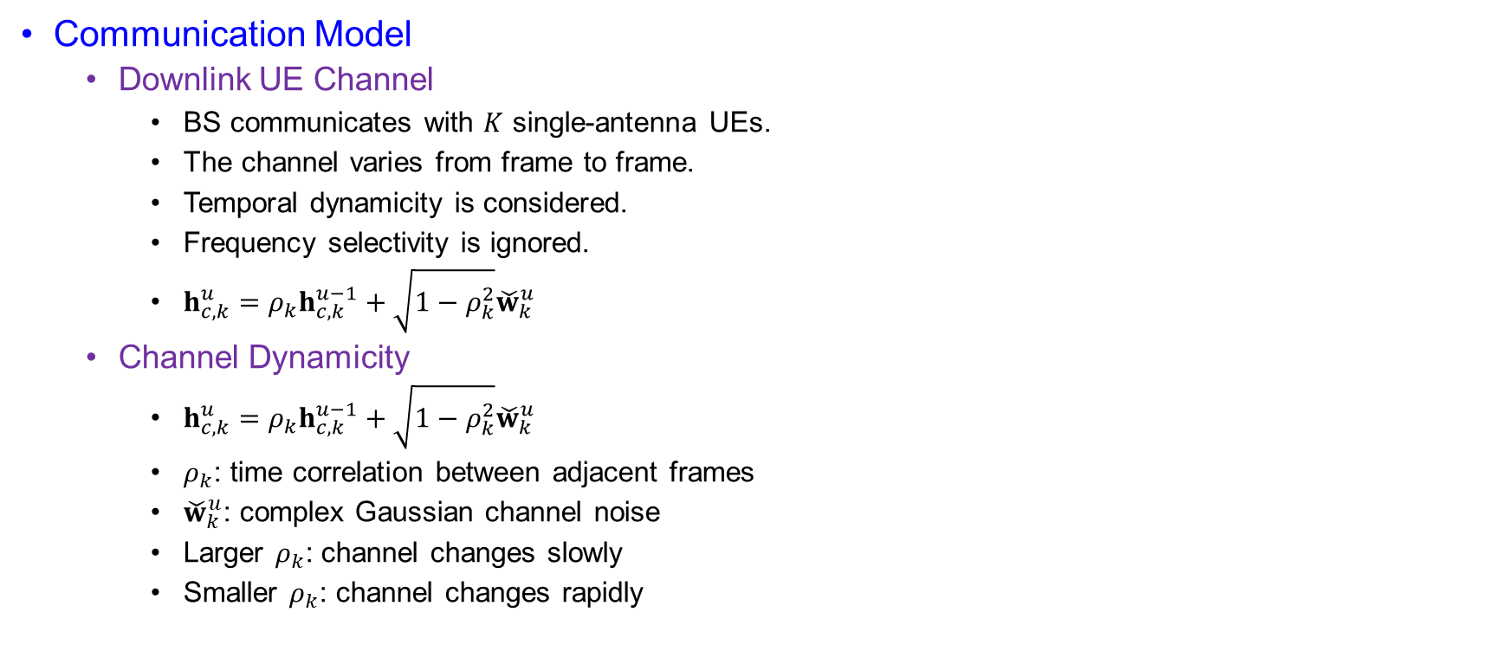
System Model
Communication Model
  Downlink UE Channel
    BS communicates with $K$ single-antenna UEs.
    The channel varies from frame to frame.
    Temporal dynamicity is considered.
    Frequency selectivity is ignored.
    $h_{c,k}^{u}=ρ_{k}h_{c,k}^{u−1}+\sqrt{1−ρ_{k}^{2}}{\check{w}}_{k}^{u}$
  Channel Dynamicity
    $h_{c,k}^{u}=ρ_{k}h_{c,k}^{u−1}+\sqrt{1−ρ_{k}^{2}}{\check{w}}_{k}^{u}$
    $ρ_{k}$: time correlation between adjacent frames
    ${\check{w}}_{k}^{u}$: complex Gaussian channel noise
    Larger $ρ_{k}$: channel changes slowly
    Smaller $ρ_{k}$: channel changes rapidly

Slide 23
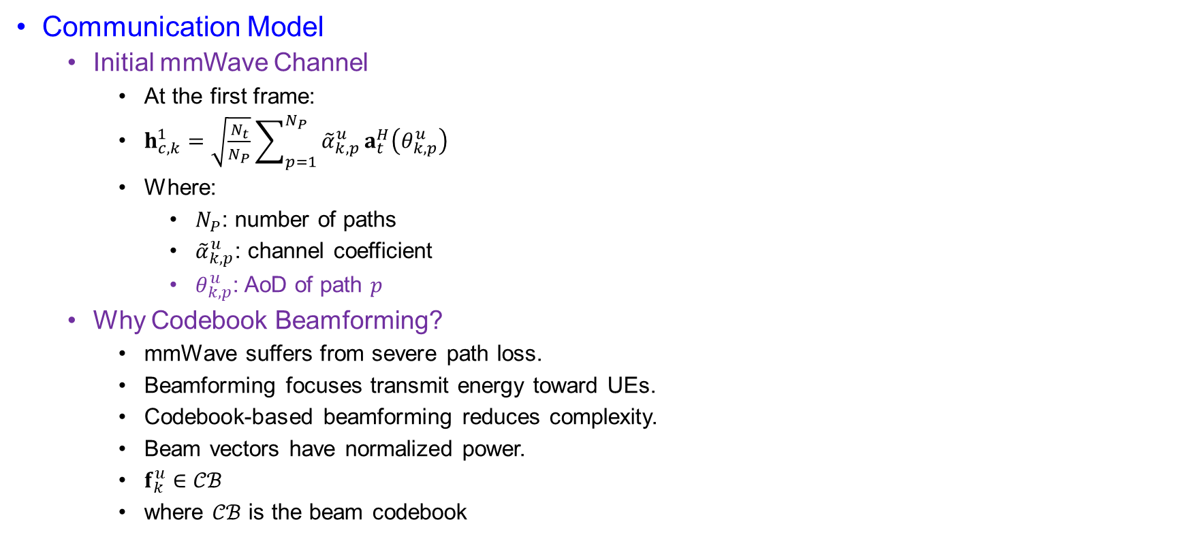
System Model
Communication Model
  Initial mmWave Channel
    At the first frame:
    $h_{c,k}^{1}=\sqrt{\frac{N_{t}}{N_{P}}}\sum_{p=1}^{N_{P}}{{\tilde{α}}_{k,p}^{u}}a_{t}^{H}\left(θ_{k,p}^{u}\right)$
    Where:
      $N_{P}$: number of paths
      ${\tilde{α}}_{k,p}^{u}$: channel coefficient
      $θ_{k,p}^{u}$: AoD of path $p$
  Why Codebook Beamforming?
    mmWave suffers from severe path loss.
    Beamforming focuses transmit energy toward UEs.
    Codebook-based beamforming reduces complexity.
    Beam vectors have normalized power.
    $f_{k}^{u}∈𝒞ℬ$
    where $𝒞ℬ$ is the beam codebook

Slide 24
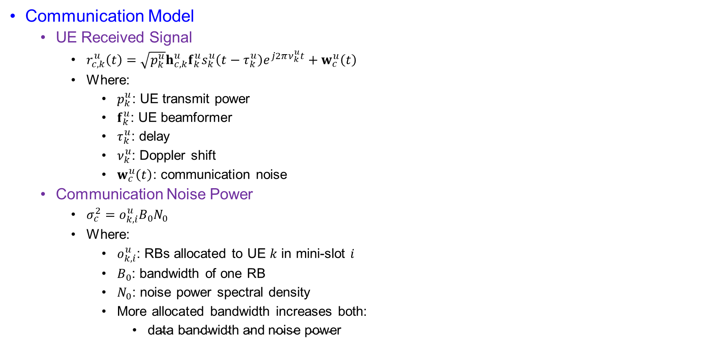
System Model
Communication Model
  UE Received Signal
    $r_{c,k}^{u}\left(t\right)=\sqrt{p_{k}^{u}}h_{c,k}^{u}f_{k}^{u}s_{k}^{u}\left(t−τ_{k}^{u}\right)e^{j2πν_{k}^{u}t}+w_{c}^{u}\left(t\right)$
    Where:
      $p_{k}^{u}$: UE transmit power
      $f_{k}^{u}$: UE beamformer
      $τ_{k}^{u}$: delay
      $ν_{k}^{u}$: Doppler shift
      $w_{c}^{u}\left(t\right)$: communication noise
  Communication Noise Power
    $σ_{c}^{2}=o_{k,i}^{u}B_{0}N_{0}$
    Where:
      $o_{k,i}^{u}$: RBs allocated to UE $k$ in mini-slot $i$
      $B_{0}$: bandwidth of one RB
      $N_{0}$: noise power spectral density
      More allocated bandwidth increases both:
        $\text{data} \text{bandwidth} \text{and} \text{noise} \text{power}$

Slide 25

System Model
Communication Model
  UE Throughput
    $R_{k}^{u}\left(o_{ki}^{u},p_{k}^{u},f_{k}^{u}\right)=\sum_{i=1}^{I}{(}\left.o_{k,i}^{u}B_{0}\right)\log_{2}\left(1+\frac{p_{k}^{u}∣h_{c,k}^{u}f_{k}^{u}∣^{2}}{o_{k,i}^{u}B_{0}N_{0}}\right)$
    This is the communication QoS metric.
  Throughput Interpretation
    Throughput improves when:
    $p_{k}^{u}↑⇒R_{k}^{u}↑$
    $∣h_{c,k}^{u}f_{k}^{u}∣^{2}↑⇒R_{k}^{u}↑$
    $o_{k,i}^{u}B_{0}↑⇒\text{more} \text{bandwidth} \text{for} \text{data} \text{transmission}$

Slide 26
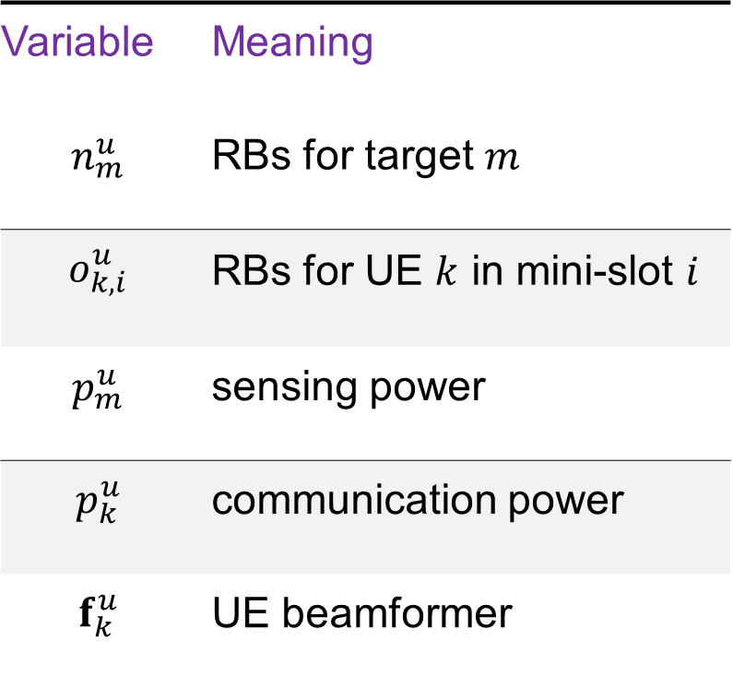
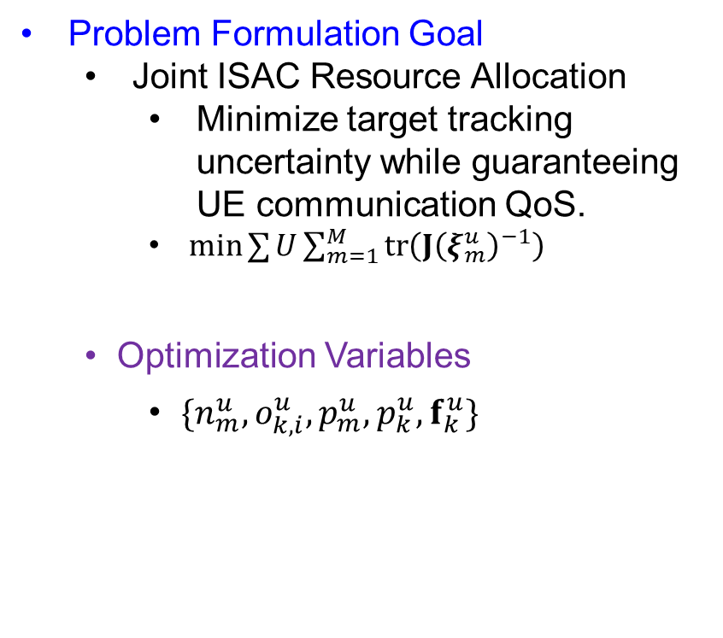
Problem Formulation
Problem Formulation Goal
  Joint ISAC Resource Allocation
    Minimize target tracking uncertainty while guaranteeing UE communication QoS.
    $min⁡∑{U}\sum_{m=1}^{M}{tr}\left(J{\left(ξ_{m}^{u}\right)}^{−1}\right)$
  Optimization Variables
    $\{n_{m}^{u},o_{k,i}^{u},p_{m}^{u},p_{k}^{u},f_{k}^{u}\}$
Variable | Meaning
$$n_{m}^{u}$$ | RBs for target $m$
$$o_{k,i}^{u}$$ | RBs for UE $k$ in mini-slot $i$
$$p_{m}^{u}$$ | sensing power
$$p_{k}^{u}$$ | communication power
$$f_{k}^{u}$$ | UE beamformer

Slide 27
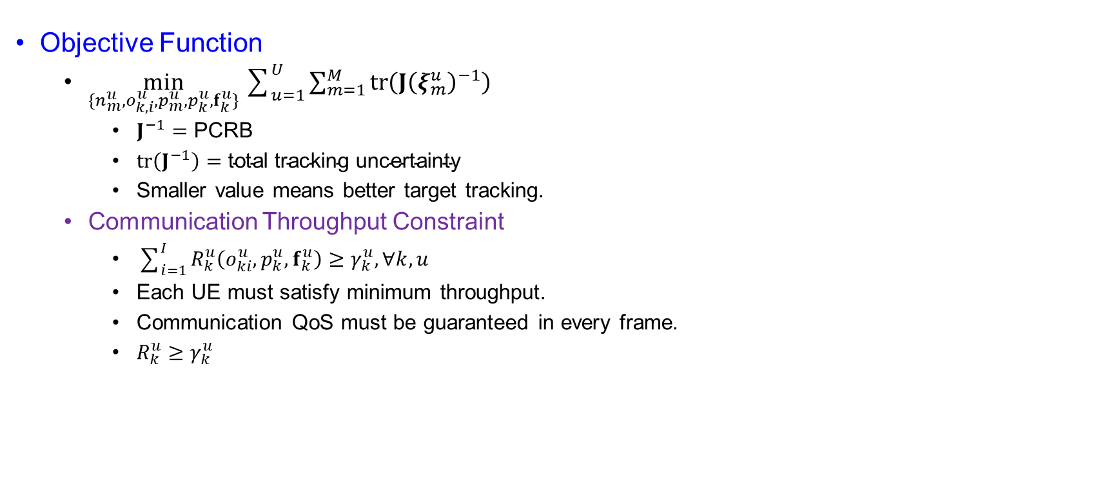
Problem Formulation
Objective Function
  $\min_{\{n_{m}^{u},o_{k,i}^{u},p_{m}^{u},p_{k}^{u},f_{k}^{u}\}}\sum_{u=1}^{U}{\sum_{m=1}^{M}{tr}}\left(J{\left(ξ_{m}^{u}\right)}^{−1}\right)$
    $J^{−1}=\text{PCRB}$
    $tr⁡\left(J^{−1}\right)=\text{total} \text{tracking} \text{uncertainty}$
    Smaller value means better target tracking.
  Communication Throughput Constraint
    $\sum_{i=1}^{I}{R_{k}^{u}\left(o_{ki}^{u},p_{k}^{u},f_{k}^{u}\right)}≥γ_{k}^{u}, ∀k,u$
    Each UE must satisfy minimum throughput.
    Communication QoS must be guaranteed in every frame.
    $R_{k}^{u}≥γ_{k}^{u}$

Slide 28
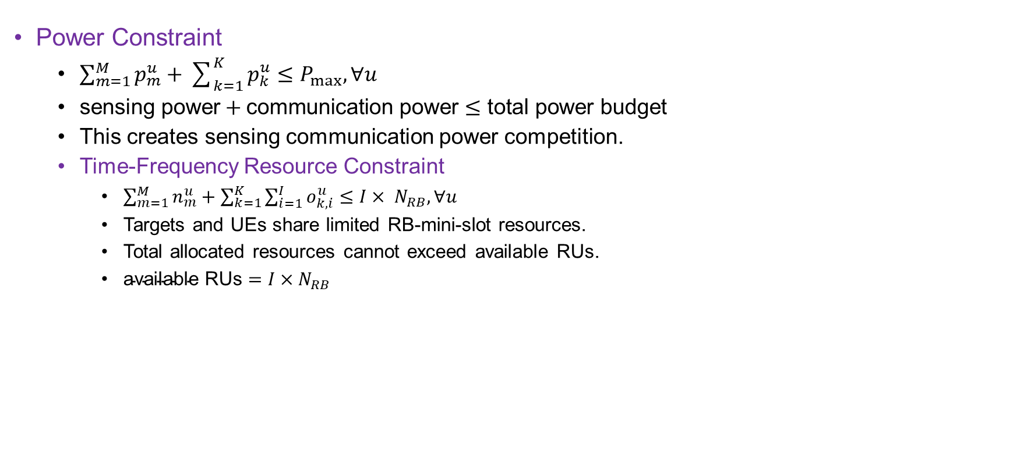
Problem Formulation
Power Constraint
  $\sum_{m=1}^{M}{p_{m}^{u}}+\sum_{k=1}^{K}{p_{k}^{u}}≤P_{max}, ∀u$
  $\text{sensing} \text{power}+\text{communication} \text{power}≤\text{total} \text{power} \text{budget}$
  This creates sensing communication power competition.
  Time-Frequency Resource Constraint
    $\sum_{m=1}^{M}{n_{m}^{u}}+\sum_{k=1}^{K}{\sum_{i=1}^{I}{o_{k,i}^{u}}}≤I× N_{RB}, ∀u$
    Targets and UEs share limited RB-mini-slot resources.
    Total allocated resources cannot exceed available RUs.
    $\text{available} \text{RUs}=I×N_{RB}$

Slide 29
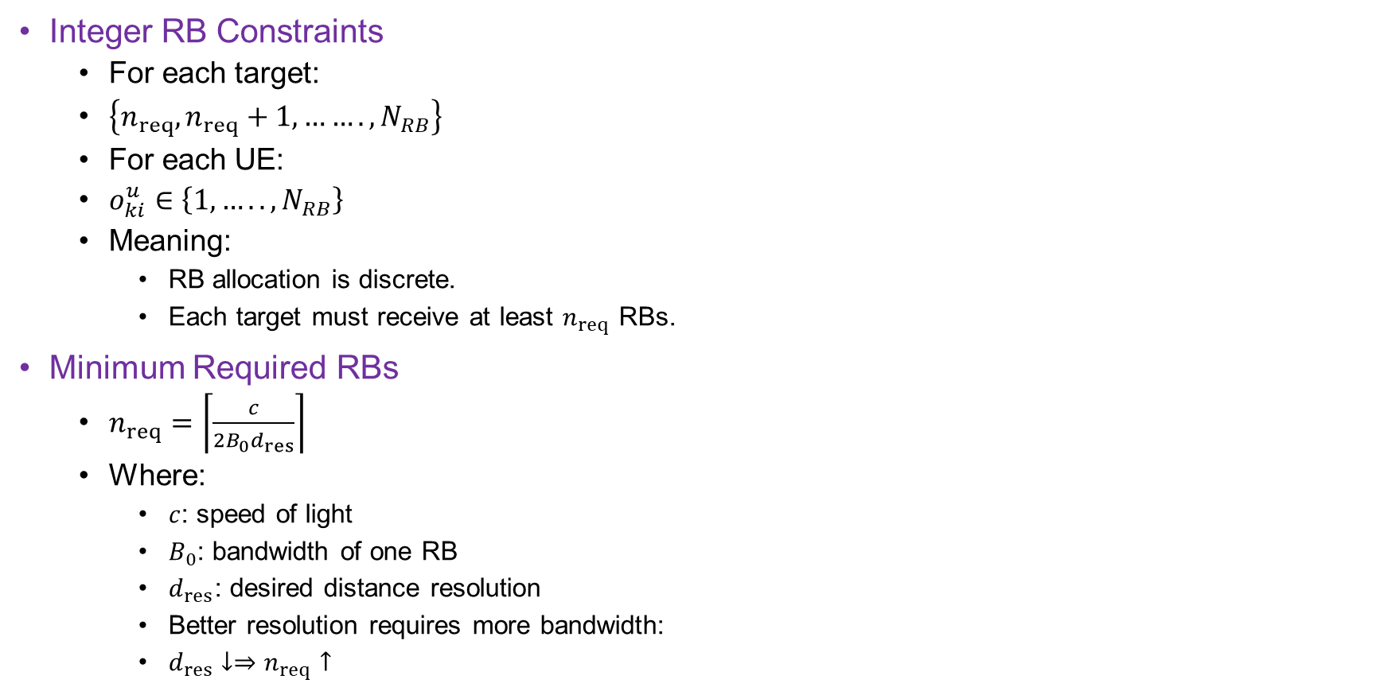
Problem Formulation
Integer RB Constraints
  For each target:
  $\left\{n_{req},n_{req}+1, …….,N_{RB}\right\}$
  For each UE:
  $o_{ki}^{u}∈\left\{1,…..,N_{RB}\right\}$
  Meaning:
    RB allocation is discrete.
    Each target must receive at least $n_{req}$ RBs.
Minimum Required RBs
  $n_{req}=\left\lceil \frac{c}{2B_{0}d_{res}}\right\rceil$
  Where:
    $c$: speed of light
    $B_{0}$: bandwidth of one RB
    $d_{res}$: desired distance resolution
    Better resolution requires more bandwidth:
    $d_{res}↓⇒n_{req}↑$

Slide 30

Problem Formulation
Why P1 Is Difficult
  P1 is a mixed-integer nonlinear programming problem because:
      $n_{m}^{u},o_{k,i}^{u}$ are integer variables.
    PCRB objective contains:
      $tr⁡\left(J^{−1}\right)$
    Throughput expression couples:
      $o_{k,i}^{u}, p_{k}^{u}, f_{k}^{u}$
    Target movement and channel variation create dynamicity.

Slide 31

Solution
Original objective:
    $\operatorname{tr}\left(J{\left(ξ_{m}\right)}^{−1}\right)$ is hard because it contains:
      matrix inverse,
      trace operation,
      nonlinear dependence on resource variable $n_{m}$.
  Goal:
    $\text{matrix} \text{PCRB} \text{objective}→\text{scalar} \text{optimization}\text{−}\text{friendly} \text{form}$

Slide 32
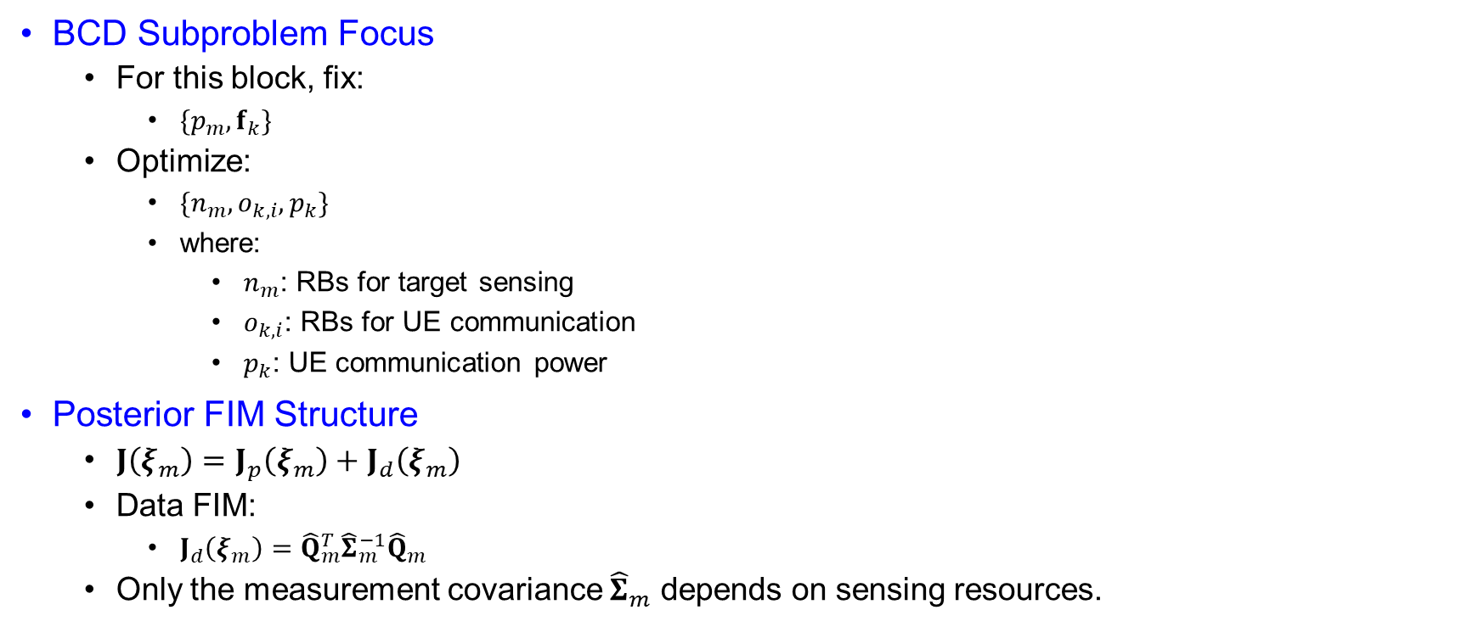
Solution
BCD Subproblem Focus
  For this block, fix:
    $\{p_{m},f_{k}\}$
  Optimize:
    $\{n_{m},o_{k,i},p_{k}\}$
    where:
      $n_{m}$: RBs for target sensing
      $o_{k,i}$: RBs for UE communication
      $p_{k}$: UE communication power
Posterior FIM Structure
  $J\left(ξ_{m}\right)=J_{p}\left(ξ_{m}\right)+J_{d}\left(ξ_{m}\right)$
  Data FIM:
    $J_{d}\left(ξ_{m}\right)={\hat{Q}}_{m}^{T}{\hat{Σ}}_{m}^{−1}{\hat{Q}}_{m}$
  Only the measurement covariance ${\hat{Σ}}_{m}$ depends on sensing resources.

Slide 33
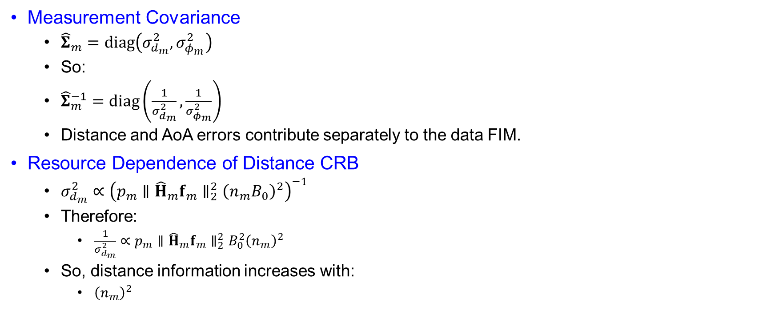
Solution
Measurement Covariance
  ${\hat{Σ}}_{m}=diag\left(σ_{d_{m}}^{2},σ_{φ_{m}}^{2}\right)$
  So:
  ${\hat{Σ}}_{m}^{−1}=diag\left(\frac{1}{σ_{d_{m}}^{2}},\frac{1}{σ_{φ_{m}}^{2}}\right)$
  Distance and AoA errors contribute separately to the data FIM.
Resource Dependence of Distance CRB
  $σ_{d_{m}}^{2}∝{\left(p_{m}∥{\hat{H}}_{m}f_{m}∥_{2}^{2}{\left(n_{m}B_{0}\right)}^{2}\right)}^{−1}$
  Therefore:
    $\frac{1}{σ_{d_{m}}^{2}}∝p_{m}∥{\hat{H}}_{m}f_{m}∥_{2}^{2}B_{0}^{2}{\left(n_{m}\right)}^{2}$
  So, distance information increases with:
    ${\left(n_{m}\right)}^{2}$

Slide 34
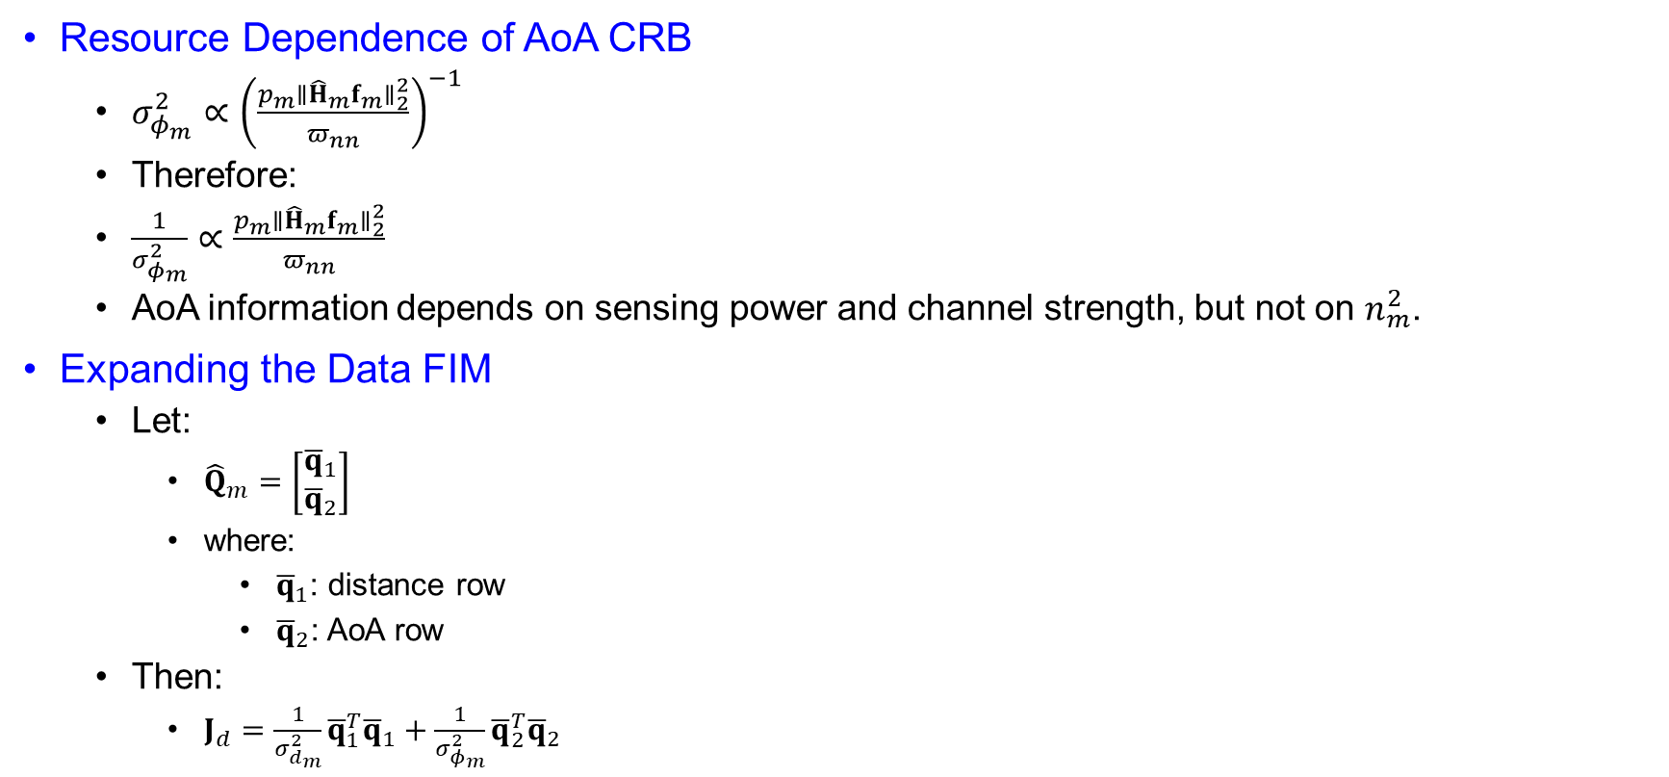
Solution
Resource Dependence of AoA CRB
  $σ_{φ_{m}}^{2}∝{\left(\frac{p_{m}∥{\hat{H}}_{m}f_{m}∥_{2}^{2}}{π_{nn}}\right)}^{−1}$
  Therefore:
  $\frac{1}{σ_{φ_{m}}^{2}}∝\frac{p_{m}∥{\hat{H}}_{m}f_{m}∥_{2}^{2}}{π_{nn}}$
  AoA information depends on sensing power and channel strength, but not on $n_{m}^{2}$.
Expanding the Data FIM
  Let:
    ${\hat{Q}}_{m}=\left[\begin{matrix}{\overline{q}}_{1} \\ {\overline{q}}_{2}\end{matrix}\right]$
    where:
      ${\overline{q}}_{1}$: distance row
      ${\overline{q}}_{2}$: AoA row
  Then:
    $J_{d}=\frac{1}{σ_{d_{m}}^{2}}{\overline{q}}_{1}^{T}{\overline{q}}_{1}+\frac{1}{σ_{φ_{m}}^{2}}{\overline{q}}_{2}^{T}{\overline{q}}_{2}$

Slide 35
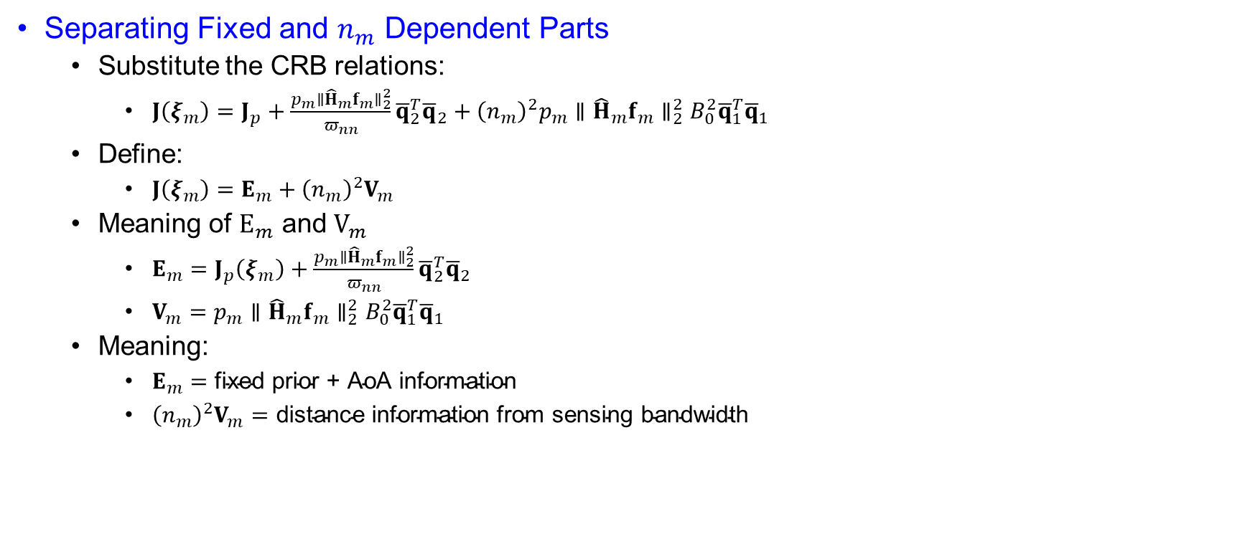
Solution
Separating Fixed and $n_{m}$ Dependent Parts
  Substitute the CRB relations:
    $J\left(ξ_{m}\right)=J_{p}+\frac{p_{m}∥{\hat{H}}_{m}f_{m}∥_{2}^{2}}{π_{nn}}{\overline{q}}_{2}^{T}{\overline{q}}_{2}+{\left(n_{m}\right)}^{2}p_{m}∥{\hat{H}}_{m}f_{m}∥_{2}^{2}B_{0}^{2}{\overline{q}}_{1}^{T}{\overline{q}}_{1}$
  Define:
    $J\left(ξ_{m}\right)=E_{m}+{\left(n_{m}\right)}^{2}V_{m}$
  Meaning of $E_{m}$ and $V_{m}$
    $E_{m}=J_{p}\left(ξ_{m}\right)+\frac{p_{m}∥{\hat{H}}_{m}f_{m}∥_{2}^{2}}{π_{nn}}{\overline{q}}_{2}^{T}{\overline{q}}_{2}$
    $V_{m}=p_{m}∥{\hat{H}}_{m}f_{m}∥_{2}^{2}B_{0}^{2}{\overline{q}}_{1}^{T}{\overline{q}}_{1}$
  Meaning:
    $E_{m}=\text{fixed} \text{prior}\text{ + }\text{AoA} \text{information}$
    ${\left(n_{m}\right)}^{2}V_{m}=\text{distance} \text{information} \text{from} \text{sensing} \text{bandwidth}$

Slide 36
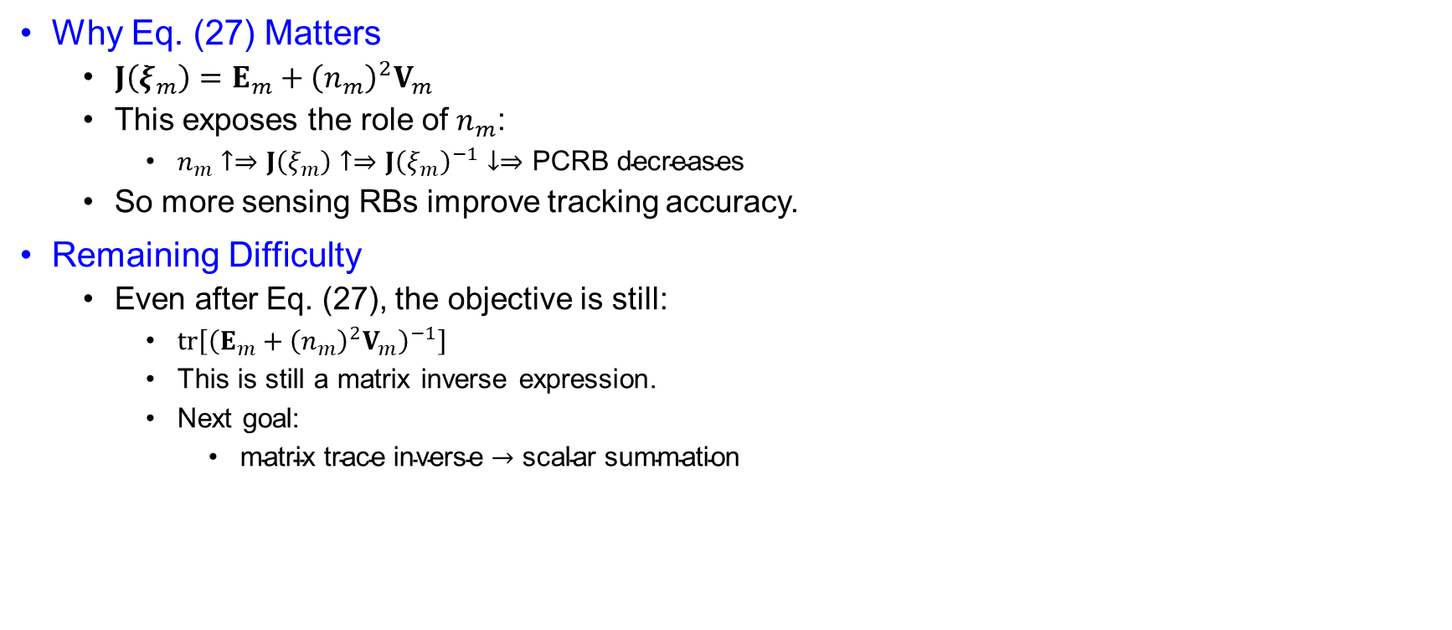
Solution
Why Eq. (27) Matters
  $J\left(ξ_{m}\right)=E_{m}+{\left(n_{m}\right)}^{2}V_{m}$
  This exposes the role of $n_{m}$:
    $n_{m}↑⇒J\left(ξ_{m}\right)↑⇒J{\left(ξ_{m}\right)}^{−1}↓⇒\text{PCRB} \text{decreases}$
  So more sensing RBs improve tracking accuracy.
Remaining Difficulty
  Even after Eq. (27), the objective is still:
    $\operatorname{tr}\left[{\left(E_{m}+{\left(n_{m}\right)}^{2}V_{m}\right)}^{−1}\right]$
    This is still a matrix inverse expression.
    Next goal:
      $\text{matrix} \text{trace} \text{inverse}→\text{scalar} \text{summation}$

Slide 37
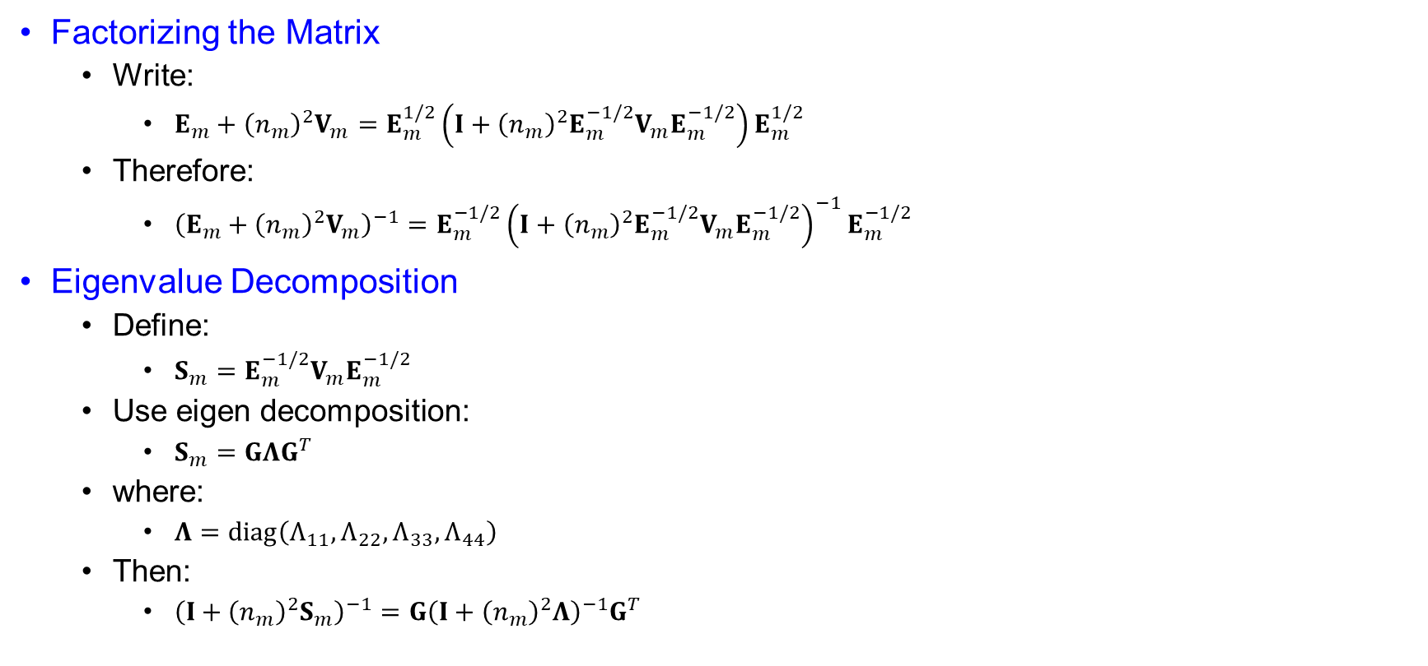
Solution
Factorizing the Matrix
  Write:
    $E_{m}+{\left(n_{m}\right)}^{2}V_{m}=E_{m}^{1/2}\left(I+{\left(n_{m}\right)}^{2}E_{m}^{−1/2}V_{m}E_{m}^{−1/2}\right)E_{m}^{1/2}$
  Therefore:
    ${\left(E_{m}+{\left(n_{m}\right)}^{2}V_{m}\right)}^{−1}=E_{m}^{−1/2}{\left(I+{\left(n_{m}\right)}^{2}E_{m}^{−1/2}V_{m}E_{m}^{−1/2}\right)}^{−1}E_{m}^{−1/2}$
Eigenvalue Decomposition
  Define:
    $S_{m}=E_{m}^{−1/2}V_{m}E_{m}^{−1/2}$
  Use eigen decomposition:
    $S_{m}=GΛG^{T}$
  where:
    $Λ=diag\left(Λ_{11},Λ_{22},Λ_{33},Λ_{44}\right)$
  Then:
    ${\left(I+{\left(n_{m}\right)}^{2}S_{m}\right)}^{−1}=G{\left(I+{\left(n_{m}\right)}^{2}Λ\right)}^{−1}G^{T}$

Slide 38

Solution
Applying Trace Cyclic Property
    $\operatorname{tr}\left[{\left(E_{m}+{\left(n_{m}\right)}^{2}V_{m}\right)}^{−1}\right]$
    becomes:
    $\operatorname{tr}\left[G^{T}E_{m}^{−1}G{\left(I+{\left(n_{m}\right)}^{2}Λ\right)}^{−1}\right]$
    Because:
    $tr⁡\left(AB\right)=tr⁡\left(BA\right)$
Scalar Summation Form
  Since:
    ${\left(I+{\left(n_{m}\right)}^{2}Λ\right)}^{−1}$ is diagonal,
    $\operatorname{tr}{=}\sum_{j=1}^{4}{\frac{{\left(G^{T}E_{m}^{−1}G\right)}_{jj}}{1+{\left(n_{m}\right)}^{2}Λ_{jj}}}$

Slide 39

Solution
Scalar Summation Form
  Define:
    $a_{mj}=\frac{1}{{\left(G^{T}E_{m}^{−1}G\right)}_{jj}}$
    $b_{mj}=a_{mj}Λ_{jj}$
    Then:
    $tr⁡\left(J^{−1}\right)=\sum_{j=1}^{4}{(}\left.a_{mj}+b_{mj}{\left(n_{m}\right)}^{2}{\left.)\right.}^{−1}\right.$
What Eq. (30) Achieves
  Before:
    $\operatorname{tr}\left[{\left(E_{m}+{\left(n_{m}\right)}^{2}V_{m}\right)}^{−1}\right]$
  After:
    $\sum_{j=1}^{4}{(}\left.a_{mj}+b_{mj}{\left(n_{m}\right)}^{2}{\left.)\right.}^{−1}\right.$
  Purpose:
    $\text{matrix} \text{inverse} \text{objective}→\text{scalar} \text{nonlinear} \text{objective}$
    Now the dependence on $n_{m}$ is explicit.

Slide 40
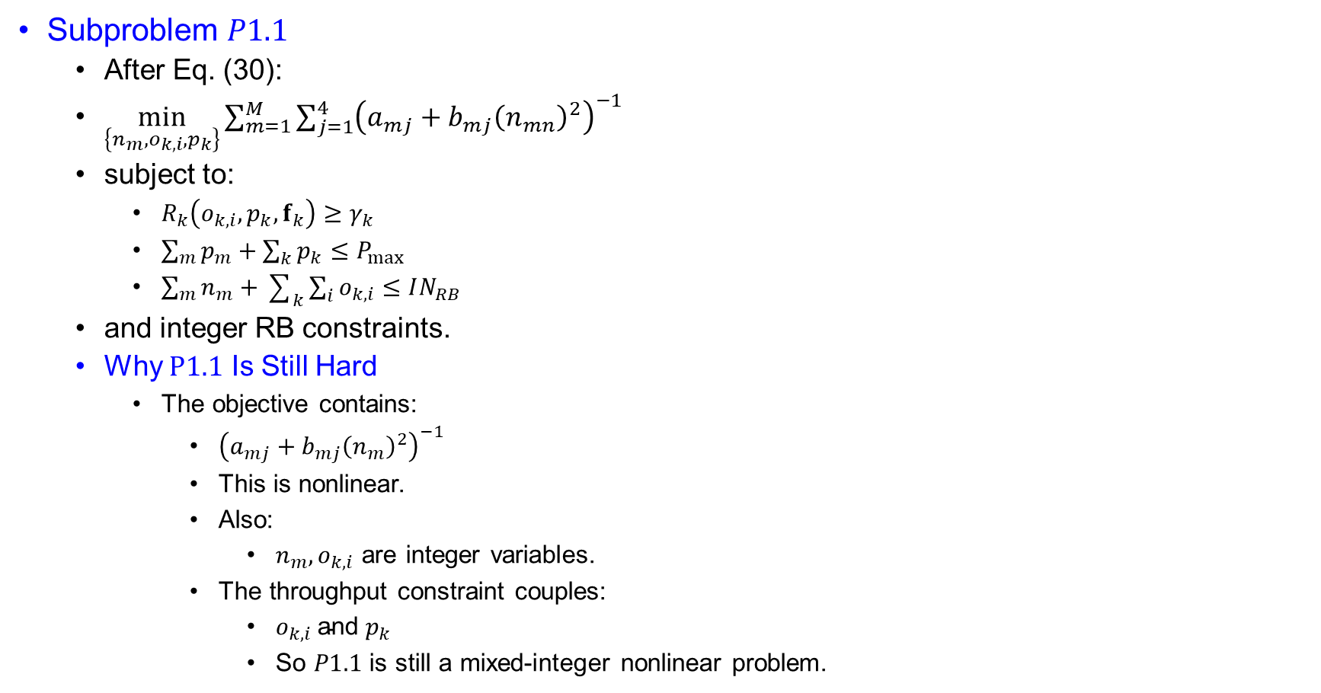
Solution
Subproblem $P1.1$
  After Eq. (30):
  $\min_{\left\{n_{m},o_{k,i},p_{k}\right\}}{\sum_{m=1}^{M}{\sum_{j=1}^{4}{{\left(a_{mj}+b_{mj}{\left(n_{mn}\right)}^{2}\right)}^{−1}}}}$
  subject to:
    $R_{k}\left(o_{k,i},p_{k},f_{k}\right)≥γ_{k}$
    $\sum_{m}{p_{m}}+\sum_{k}{p_{k}}≤P_{max}$
    $\sum_{m}{n_{m}}+\sum_{k}{\sum_{i}{o_{k,i}}}≤IN_{RB}$
  and integer RB constraints.
  Why $P1.1$ Is Still Hard
    The objective contains:
      ${\left(a_{mj}+b_{mj}{\left(n_{m}\right)}^{2}\right)}^{−1}$
      This is nonlinear.
      Also:
        $n_{m}, o_{k,i}$ are integer variables.
      The throughput constraint couples:
        $o_{k,i} \text{and} p_{k}$
        So $P1.1$ is still a mixed-integer nonlinear problem.

Slide 41

Solution
Introducing Auxiliary Variable $z_{mj}$
  Introduce:
    $z_{mj}≥0$
  such that:
    ${\left(a_{mj}+b_{mj}{\left(n_{m}\right)}^{2}\right)}^{−1}≤z_{mj}$
  Then minimize:
    $\min_{\left\{n_{m},o_{k,i},z_{mj}\right\}}{\sum_{m=1}^{M}{\sum_{j=1}^{4}{z_{mj}}}}$
    This is an epigraph transformation.
    Purpose:
      $\text{nonlinear} \text{inverse} \text{objective}→\text{linear} \text{objective} \text{with} \text{nonlinear} \text{constraint}$

Slide 42

Solution
Constraint Reformulation
  From:
    ${\left(a_{mj}+b_{mj}{\left(n_{m}\right)}^{2}\right)}^{−1}≤z_{mj}$
  we obtain:
    $\frac{1}{z_{mj}}−\left(a_{mj}+b_{mj}{\left(n_{m}\right)}^{2}\right)≤0$
  So $P1.2$ becomes:
  $\min_{\left\{n_{m},o_{k,i},p_{k}\right\}}{\sum_{m,j}{z_{mj}}}$
    subject to:
    $\frac{1}{z_{mj}}−\left(a_{mj}+b_{mj}{\left(n_{m}\right)}^{2}\right)≤0$
    and the remaining constraints.

Slide 43

Solution
Why $P1.2$ Is Non-Convex
  The constraint is:
  $\frac{1}{z_{mj}}−\left(a_{mj}+b_{mj}{\left(n_{m}\right)}^{2}\right)≤0$
  Here:
    $\frac{1}{z_{mj}}$
    is convex for $z_{mj}>0$.
    Also:
    ${\left(n_{m}\right)}^{2}$
    is convex.
  So, the left side is:
    $\text{convex}−\text{convex}$
  This is a DC constraint, therefore non-convex

Slide 44

Solution
SCA / Taylor Approximation
Linearize:
  ${\left(n_{m}\right)}^{2}$
  around previous iteration $n_{m}^{∗}$:
    ${\left(n_{m}\right)}^{2}≈{\left(n_{m}^{∗}\right)}^{2}+2n_{m}^{∗}\left(n_{m}−n_{m}^{∗}\right)$
  Then:
    $\frac{1}{z_{mj}}−\left[a_{mj}+b_{mj}\left({\left(n_{m}^{∗}\right)}^{2}+2n_{m}^{∗}\left(n_{m}−n_{m}^{∗}\right)\right)\right]≤0$
  This is the SCA approximation used in $P1.3$.

Slide 45
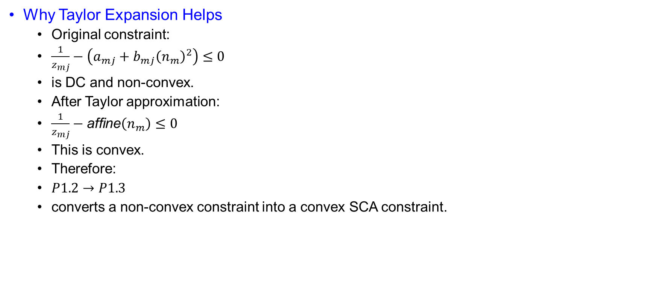
Solution
Why Taylor Expansion Helps
  Original constraint:
  $\frac{1}{z_{mj}}−\left(a_{mj}+b_{mj}{\left(n_{m}\right)}^{2}\right)≤0$
  is DC and non-convex.
  After Taylor approximation:
  $\frac{1}{z_{mj}}−\text{affine}\left(n_{m}\right)≤0$
  This is convex.
  Therefore:
  $P1.2→P1.3$
  converts a non-convex constraint into a convex SCA constraint.

Slide 46
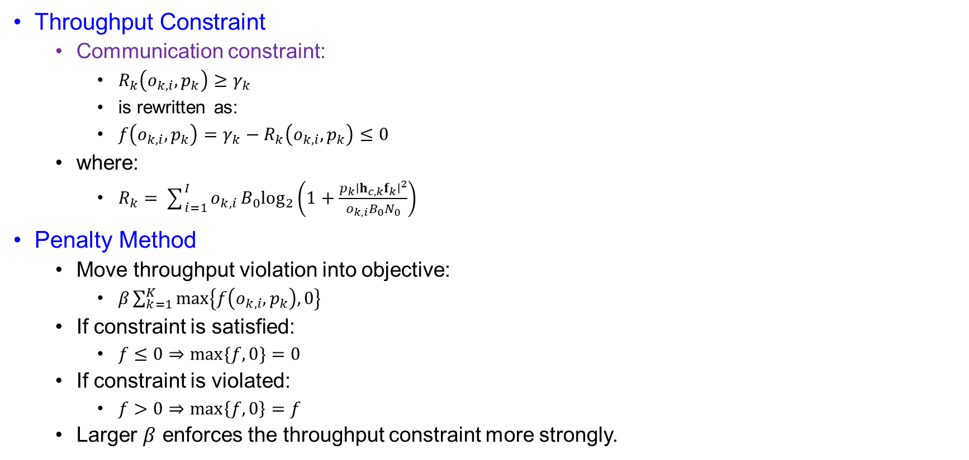
Solution
Throughput Constraint
  Communication constraint:
    $R_{k}\left(o_{k,i},p_{k}\right)≥γ_{k}$
    is rewritten as:
    $f\left(o_{k,i},p_{k}\right)=γ_{k}−R_{k}\left(o_{k,i},p_{k}\right)≤0$
  where:
    $R_{k}=\sum_{i=1}^{I}{o_{k,i}}B_{0}\log_{2}\left(1+\frac{p_{k}∣h_{c,k}f_{k}∣^{2}}{o_{k,i}B_{0}N_{0}}\right)$
Penalty Method
  Move throughput violation into objective:
    $β\sum_{k=1}^{K}{max}\left\{f\left(o_{k,i},p_{k}\right),0\right\}$
  If constraint is satisfied:
    $f≤0⇒max⁡\{f,0\}=0$
  If constraint is violated:
    $f>0⇒\max\left\{f,0\right\}=f$
  Larger $β$ enforces the throughput constraint more strongly.

Slide 47
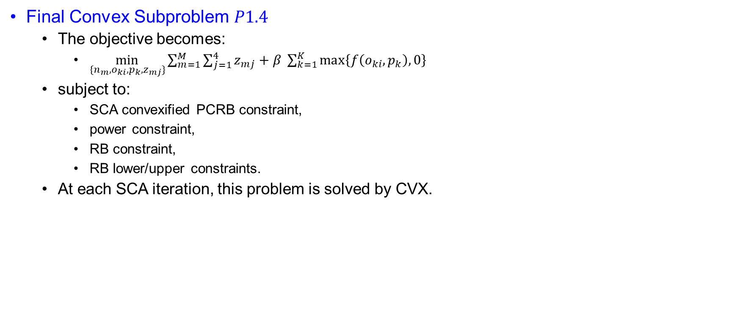
Solution
Final Convex Subproblem $P1.4$
  The objective becomes:
    $\min_{\{n_{m},o_{ki},p_{k},z_{mj}\}}{\sum_{m=1}^{M}{\sum_{j=1}^{4}{z_{mj}+β \sum_{k=1}^{K}{\max\left\{f\left(o_{ki},p_{k}\right),0\right\}}}}}$
  subject to:
    SCA convexified PCRB constraint,
    power constraint,
    RB constraint,
    RB lower/upper constraints.
  At each SCA iteration, this problem is solved by CVX.

Slide 48
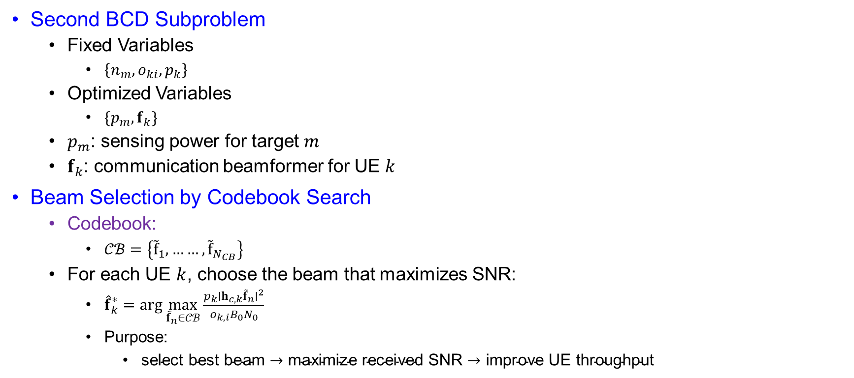
Solution
Second BCD Subproblem
  Fixed Variables
    $\left\{n_{m},o_{ki},p_{k}\right\}$
  Optimized Variables
    $\{p_{m},f_{k}\}$
  $p_{m}$: sensing power for target $m$
  $f_{k}$: communication beamformer for UE $k$
Beam Selection by Codebook Search
  Codebook:
    $𝒞ℬ=\left\{{\tilde{f}}_{1},……,{\tilde{f}}_{N_{CB}}\right\}$
  For each UE $k$, choose the beam that maximizes SNR:
    ${\hat{f}}_{k}^{∗}=\arg{\max_{{\tilde{f}}_{n}∈𝒞ℬ}}\frac{p_{k}∣h_{c,k}{\tilde{f}}_{n}∣^{2}}{o_{k,i}B_{0}N_{0}}$
    Purpose:
      $\text{select} \text{best} \text{beam}→\text{maximize} \text{received} \text{SNR}→\text{improve} \text{UE} \text{throughput}$

Slide 49
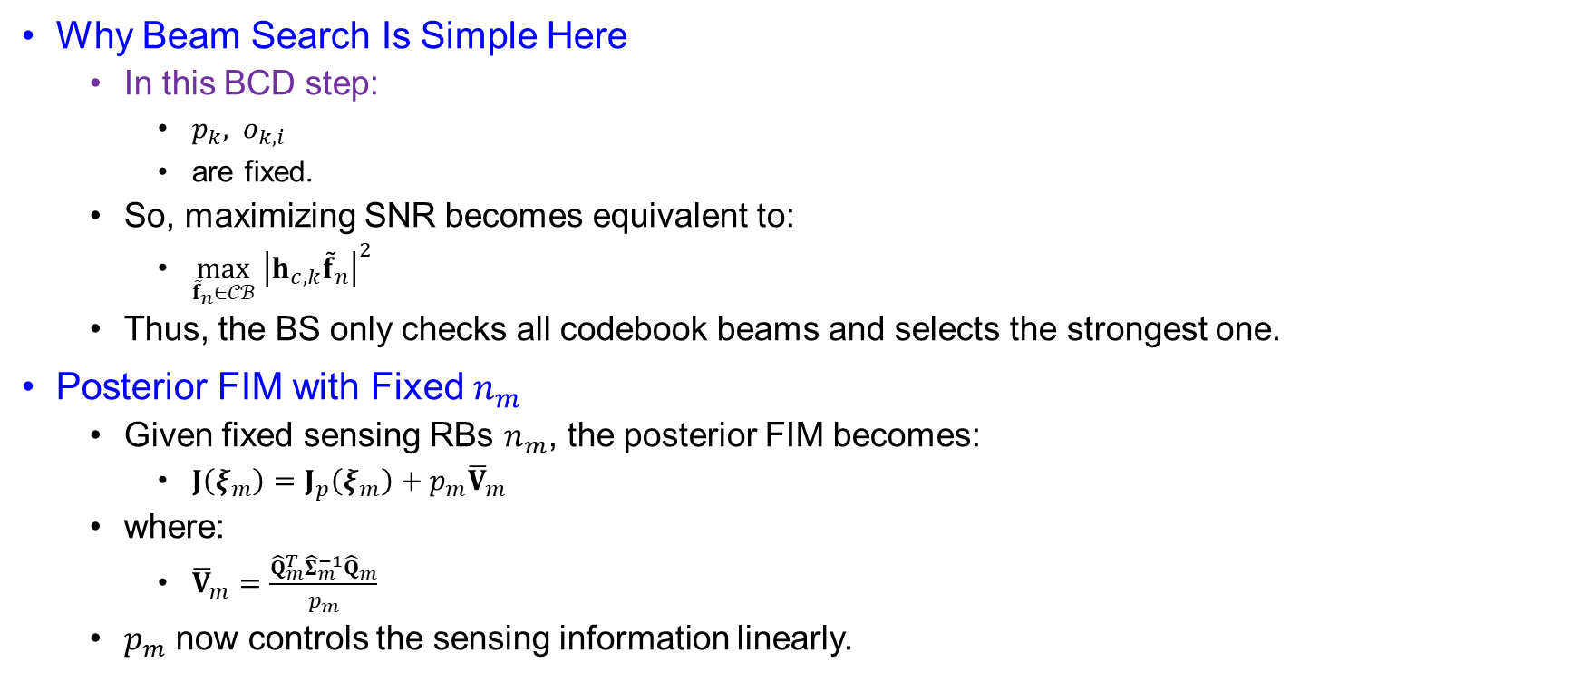
Solution
Why Beam Search Is Simple Here
  In this BCD step:
    $p_{k}, o_{k,i}$
    are fixed.
  So, maximizing SNR becomes equivalent to:
    $\max_{{\tilde{f}}_{n}∈𝒞ℬ} {\left|h_{c,k}{\tilde{f}}_{n}\right|}^{2}$
  Thus, the BS only checks all codebook beams and selects the strongest one.
Posterior FIM with Fixed $n_{m}$
  Given fixed sensing RBs $n_{m}$, the posterior FIM becomes:
    $J\left(ξ_{m}\right)=J_{p}\left(ξ_{m}\right)+p_{m}{\overline{V}}_{m}$
  where:
    ${\overline{V}}_{m}=\frac{{\hat{Q}}_{m}^{T}{\hat{Σ}}_{m}^{−1}{\hat{Q}}_{m}}{p_{m}}$
  $p_{m}$ now controls the sensing information linearly.

Slide 50

Solution
Why This Form Matters
  The new form:
    $J\left(ξ_{m}\right)=J_{p}\left(ξ_{m}\right)+p_{m}{\overline{V}}_{m}$
  is similar to the previous form:
    $J\left(ξ_{m}\right)=E_{m}+n_{m}^{2}V_{m}$
  Previous block:
    $n_{m}^{2} \text{was} \text{the} \text{main} \text{sensing} \text{variable}$
  Current block:
    $p_{m} \text{is} \text{the} \text{main} \text{sensing} \text{variable}$

Slide 51

Solution
Transforming PCRB Objective
  Using the same matrix transformation as Eq. (30):
    $\operatorname{tr}\left[{\left(J_{p}+p_{m}{\overline{V}}_{m}\right)}^{−1}\right]$
    can be written as:
    $\sum_{j=1}^{4}{(}\left.{\overline{a}}_{mj}+{\overline{b}}_{mj}p_{m}{\left.)\right.}^{−1}\right.$
    where:
    ${\overline{a}}_{mj},{\overline{b}}_{mj}$ are constants with respect to $p_{m}$.

Slide 52

Solution
Subproblem $P2.1$
  After beam selection, solve:
    $\min_{\{p_{m},f_{k}\}}\sum_{m=1}^{M}{\sum_{j=1}^{4}{(}}\left.{\overline{a}}_{mj}+{\overline{b}}_{mj}p_{m}{\left.)\right.}^{−1}\right.$
    subject to:
      $R_{k}\left(o_{k,i} , p_{k} , f_{k}\right)≥γ_{k}$
      $\sum_{m=1}^{M}{p_{m}}+\sum_{k=1}^{K}{p_{k}}≤P_{max}$
  Since $f_{k}$ is selected by codebook search, CVX mainly solves for:
  $\left\{p_{m}\right\}$

Slide 53

Solution
Why $P2.1$ Is Easier
  After fixing:
    $\left\{n_{m},o_{ki},p_{k}\right\}$
  and selecting:
    $f_{k}$
  the remaining variable is sensing power:
    $p_{m}$
  The objective:
    $\sum_{m,j}{(}\left.{\overline{a}}_{mj}+{\overline{b}}_{mj}p_{m}{\left.)\right.}^{−1}\right.$
  is convex in $p_{m}$when:
    ${\overline{a}}_{mj}>0, {\overline{b}}_{mj}>0$
  So $P2.1$can be solved by CVX.

Slide 54

Solution
BCD Algorithm Flow
  Initialize feasible:
    $p_{m},f_{k}$
  Then repeat:
    Fix $\left\{p_{m},f_{k}\right\}$
  Solve $P1.4$ by CVX to obtain:
    $\left\{n_{m},o_{ki},p_{k}\right\}$
    Fix $\left\{n_{m},o_{ki},p_{k}\right\}$
  Select $f_{k}$ by codebook search
  Solve $P2.1$ by CVX to obtain:
    $\left\{p_{m}\right\}$
  Repeat until objective reduction is small.

